Slide 1
REMOTELY
OPERATED VEHICLE
(ROV)
MUHAMMAD NAJMI BIN NOR HISHAM 1910673

Slide 2
TABLE OF CONTENTS
01
02
03
HISTORY
COMPONENTS
LIMITATION

Slide 3
01
HISTORY OF ROV
You can enter a subtitle here if you need it

Slide 4
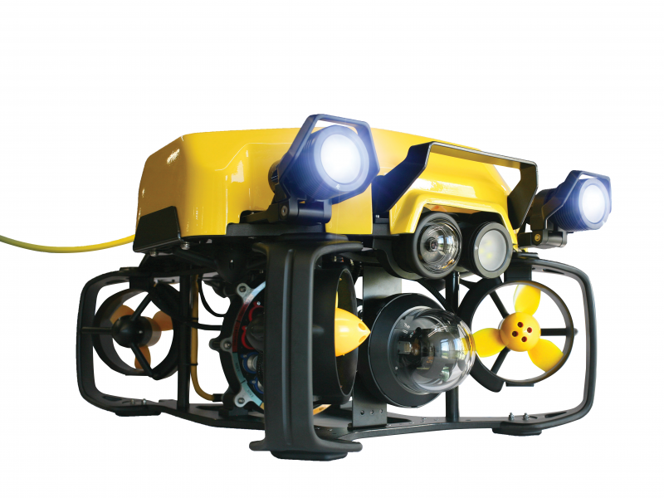
INTRODUCTION
ROV is a short form for Remotely Operated Vehicle.
The system is consider as unmanned system because the vehicle does it function without a man use it inside the vehicle but it being controlled from other location. It being used commonly in underwater mission such as collecting a samples of substance in water.

Slide 5
HISTORY
1980s - 1990s
ROV can perform more wider task from the current technology in computer.
Implementation of Digital Control System make the ROV can establish more complex task.
The system is more precise.
1950s - 1970s
ROV in early development process to explore in the deep sea ocean for many purpose.
US Navy funded to find nuclear bomb in Mediterranean Sea.
Also use for offshore drilling operation.

Slide 6
HISTORY
2010 - current
Minimisation of size of the ROV.
Lightweight vehicle make it much easier in deep sea ocean.
2000
Technology in Imaging has been start to develop and ROV implemented it.
Many unexplored location in deep sean can be explored and researched using 3D high definition camera.
3D mapping capabilities has make the research much faster.

Slide 7
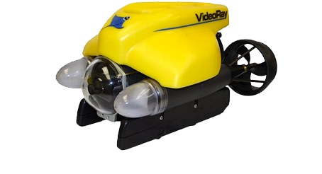
TYPE OF ROV
OBSERVATION ROV
Use for specific task in surveying and visual inspection task.
Equipped with sensor and camera.
Ex : VideoRay Pro4

Slide 8
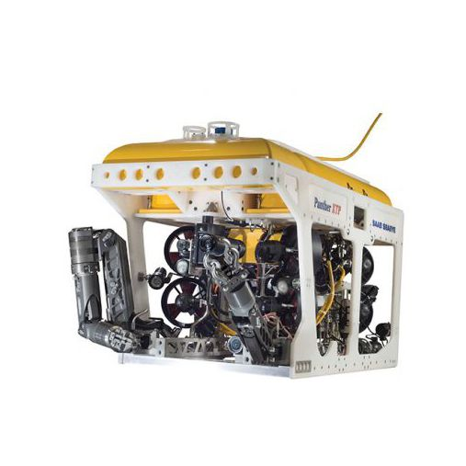
TYPE OF ROV
WORK-CLASS ROV
Use for heavy duty task such as maintenance and construction project in deep sea.
Included with many expensive accessories like camera and sensor
Ex : Seaeye Panther XT Plus

Slide 9
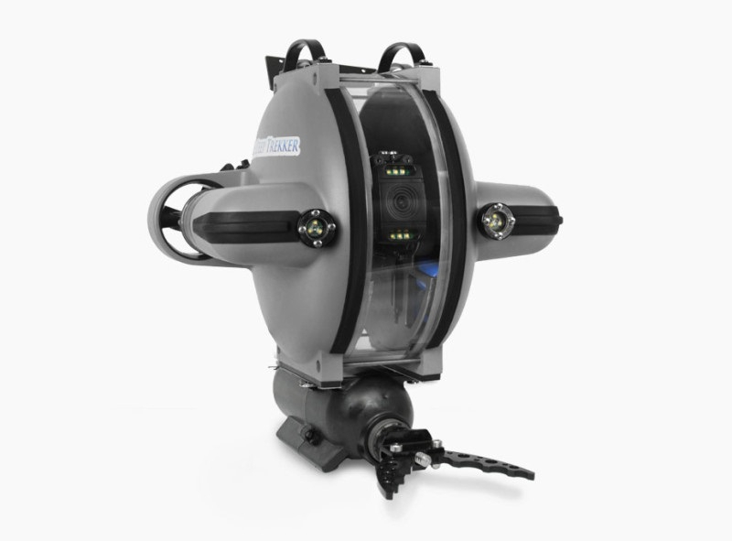
TYPE OF ROV
Inspection ROV
Equipped with high resolution camera for inspection mission.
Have a good sensors and measurements tool
Ex : Deep Trekker DTG3
High imaging technology
Versatile and portable
Featured with good sensors and measurements tools
Deep Trekker DTG3

Slide 10
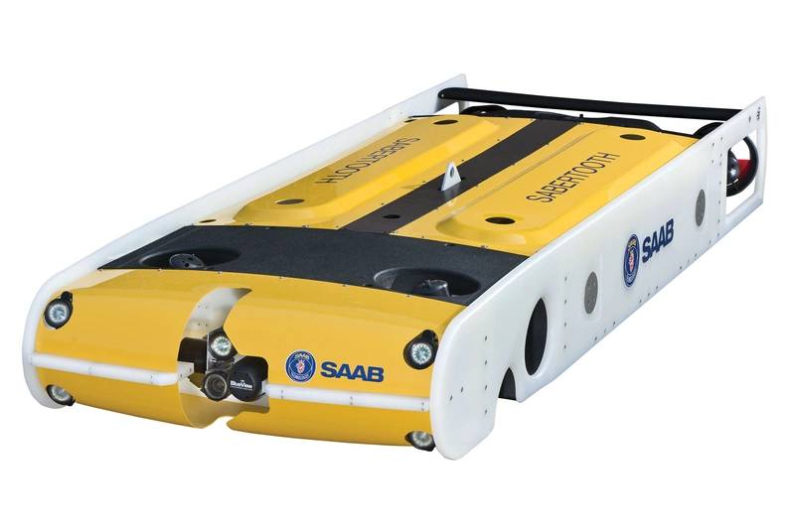
TYPE OF ROV
HYBRID ROV
Have more special ability than other ROV because has autonomous feature.
Ex : Saab Seaeye Sabertooth

Slide 11
02
MAIN COMPONENTS OF ROV

Slide 12
MAIN COMPONENTS IN ROV
HULL DESIGN
POWER MANAGEMENT
PROPULSION
DATA COLLECTION & TRANSMISSION
NAVIGATION SYSTEM & CONTROL

Slide 13
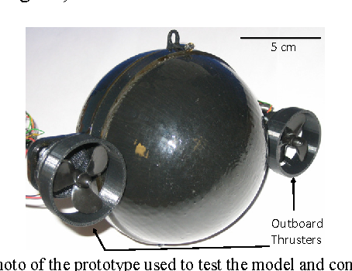
HULL DESIGN
Spherical Hull
Box Shaped Hull
Torpedo Hull
Has limit in payload capacity
Camera can be implemented fully due to 360 degree visibility

Slide 14
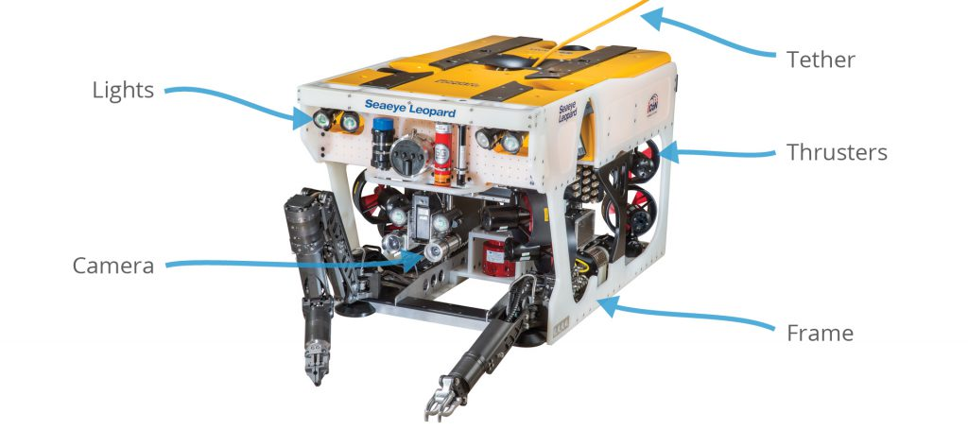
HULL DESIGN
Spherical Hull
Box Shaped Hull
Torpedo Hull
Easy in maintenance
Provide great flexibility for ROV configuration because can add and remove part easily.
Can give higher payload capacity.

Slide 15
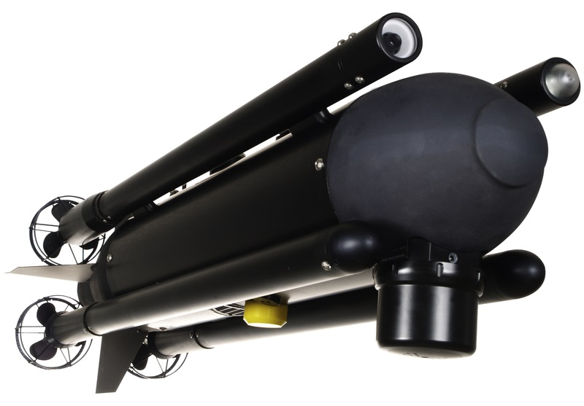
HULL DESIGN
Spherical Hull
Box Shaped Hull
Torpedo Hull
Design for fast speed in underwater.
Material should be strong and durable.
Usually in military application.
Can change direction quickly.

Slide 16
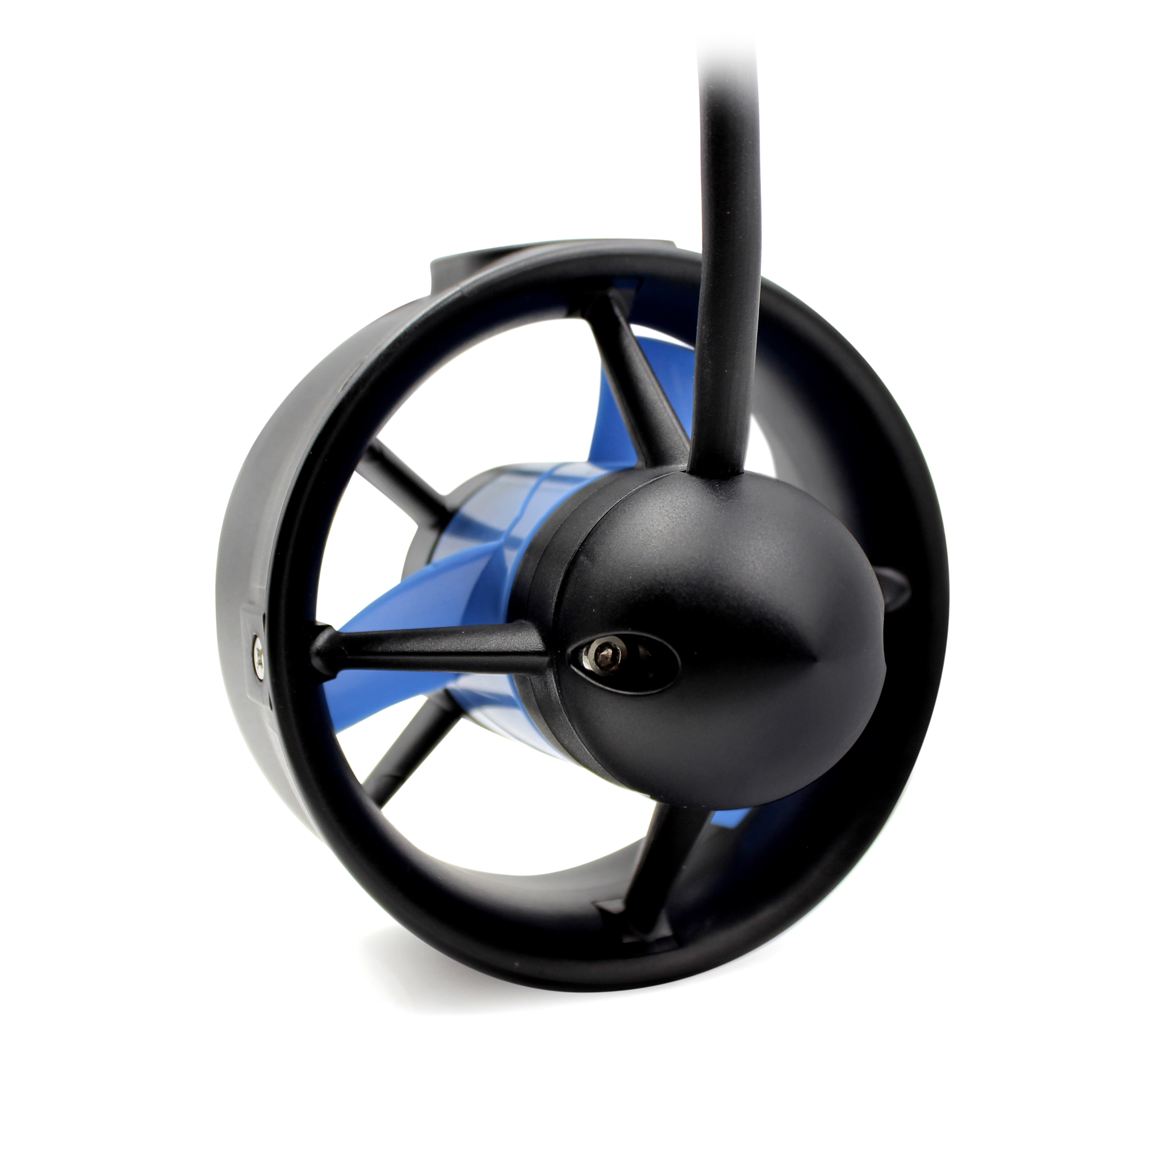
PROPULSION
ELECTRIC THRUSTER
The usual type of propulsion.
Located at the side or rear.
Powered by electricity
ADVANTAGE: minimum maintenance required
DISADVANTAGE: has limited speed, operating time

Slide 17
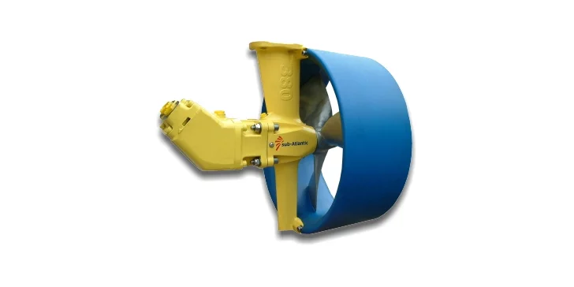
PROPULSION
HYDRAULIC THRUSTER
Use for high speed type ROV.
Powered by hydraulic fluid.
ADVANTAGE: Speed
DISADVANTAGE: Expensive and high maintenance required

Slide 18
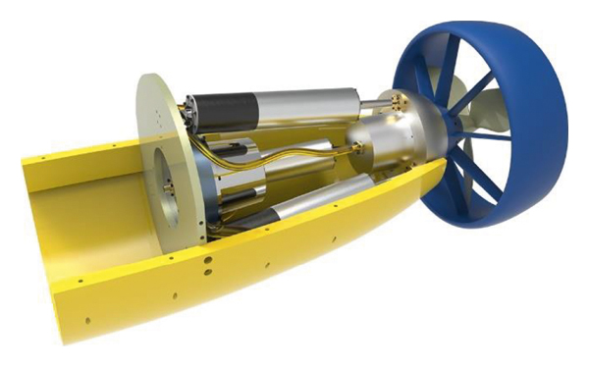
PROPULSION
JET DUCK THRUSTER
Can be easily move in many direction
Move by using accelerates a flow of water through nozzle and create opposite forward force
ADVANTAGE: Maneuverable, work efficiently
DISADVANTAGE: Noisy, regular maintenance required, can cause erosion

Slide 19
NAVIGATION SYSTEMS & CONTROL
DISPLAY | Display all information about the current ROV situation like the current depth.
INERTIAL MEASUREMENT UNIT (IMU) | Essential for figuring the ROV orientation,velocity and acceleration.
Camera | Take an image of deep sea surrounding
Joystick | Control the ROV movements
Manipulators | Help manipulate object with ROV
Depth Sensor | Measure depth of current position of ROV
Sonar | 3D mapping to figure out the surrounding
Global Navigation Satellite System (GNSS) | Locate the ROV on surface

Slide 20
DATA COLLECTION & TRANSMISSION
CAMERA
SENSORS
To capture image or video of deep sea as visual data
There is variety of sensor to detect the current ROV orientation
LIGHTS
TETHER
Cable connection from ROV to operator to provide power and data to operator
Helping camera to capture good image with high-intensity LED light

Slide 21
POWER MANAGEMENT
Power Supply | Depend on each ROV whether it internal ( battery pack) or external (tethered)
Power Distribution System | Distributes power from power supply to other components
Power Regulation System | Regulated the voltage and current of the power supply until reach specific value. (Voltage regulators)
Power Monitoring System | Monitored the power from components and give feedback to Power Regulation System.
Power Management Software | Optimize the power usage to make the mission going out most efficiently.
Energy Storage System | Store energy generated by ROV’s components for later use.

Slide 22
03
LIMITATIONS

Slide 23
LIMITATION
LIMITED RANGE
HUMAN CONTROL
Tether ROV has limited range of operation based in its cable length. It will limit the outcome of the mission
Error might occurred during operator gathering data when control the ROV.
SENSOR QUALITY
The data collection depends fully in sensors. Some sensor might have bad quality and will effect the data collection

